Slide 1
Statistical Methodology for
Software Engineering
Hadas Lapid, PhD
Statistics for Software
Engineers
Notes:
An Introduction to Statistical Methods and Data Analysis 7th Edition
R. Lyman Ott Michael Longnecker
Chap. 6.3, page 315

Slide 2
Contents
Kolmogorov-Smirnov test
Statistics for Software
Engineers

Slide 3
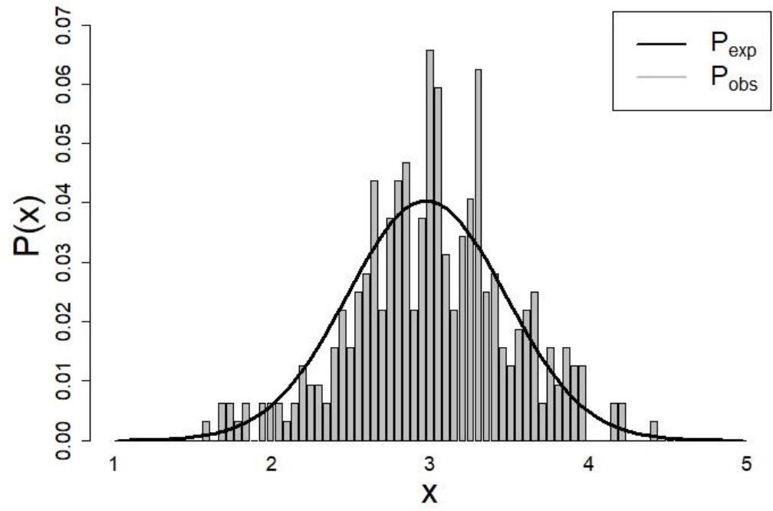
Kolmogorov-Smirnov test definition
The K–S test is a non-parametric test (does not
require normality) that compares between two
distributions of continuous/ordinal, 1-dimensional
variables.
H₀: X~N(μ,σ)
H₁: X≠N(μ,σ)
Statistics for Software
Engineers
Notes:
https://en.wikipedia.org/wiki/Kolmogorov%E2%80%93Smirnov_test

Slide 4
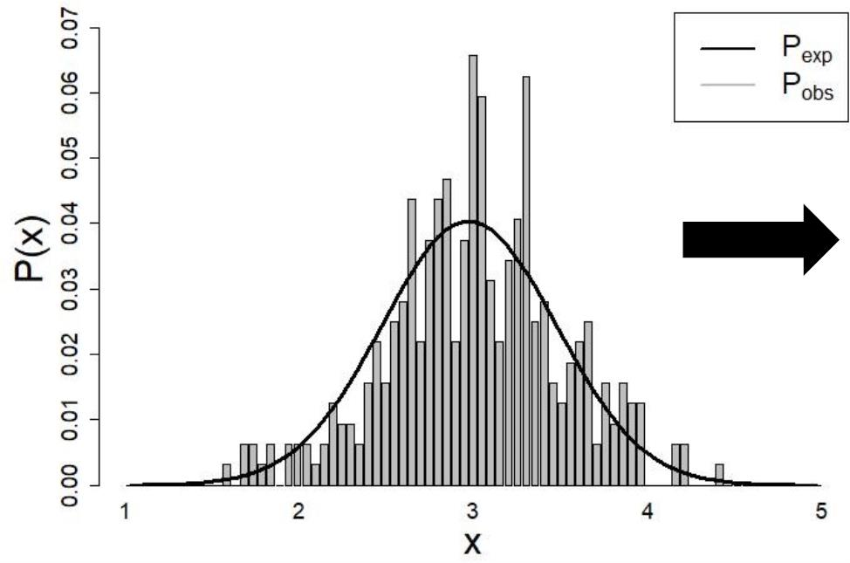
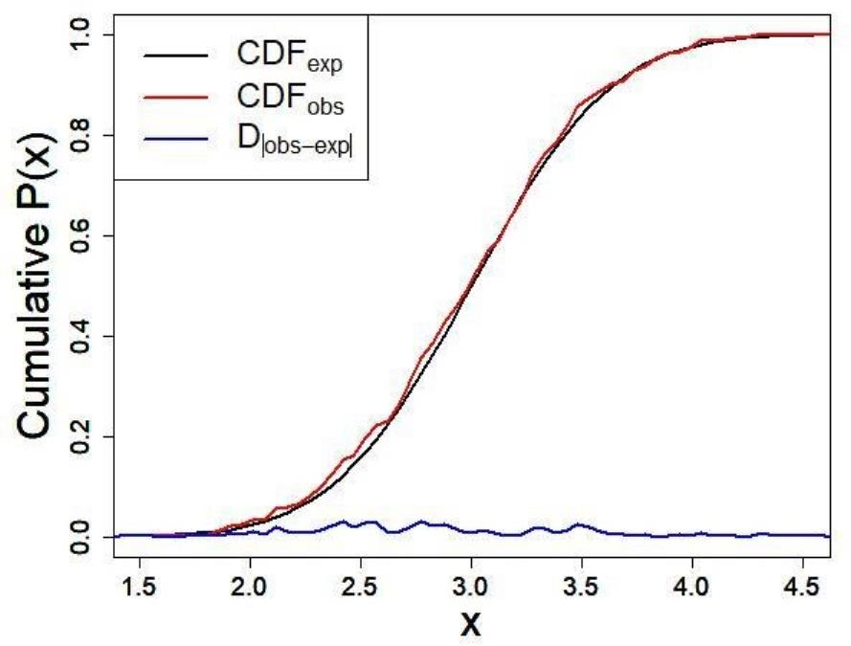
From Probability distribution Function to
Cumulative Distribution Function
Statistics for Software
Engineers

Slide 5
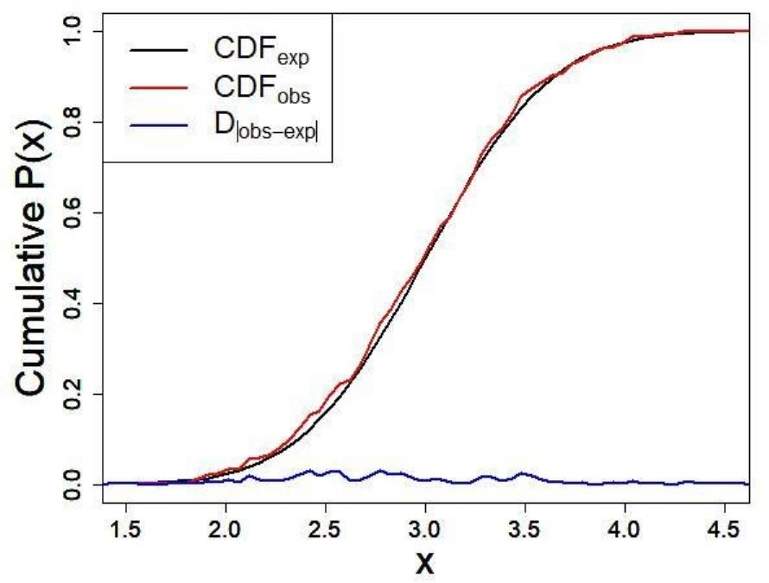
Kolmogorov-Smirnov statistic
The K–S statistic quantifies the distance between empirical cumulative distribution function and a reference cumulative distribution function, or between the empirical cumulative distribution functions of two samples.
Statistics for Software
Engineers

Slide 6
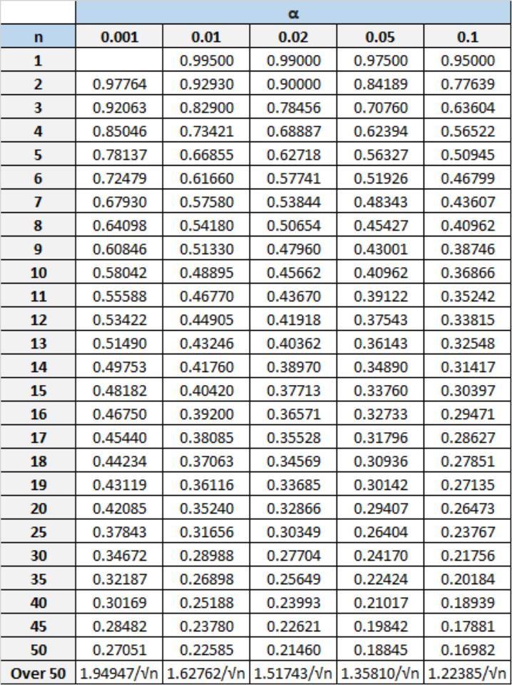
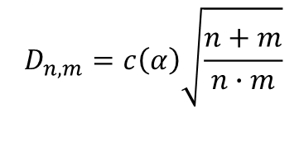
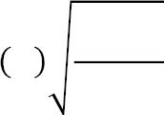
Critical Values for Kolmogorov-Smirnov Test
When comparing between
two groups of size m and n
ꢀ = ꢀ
ꢀ +ꢀ
ꢀ ∙ ꢀ
ꢀ,ꢀ
ꢀ
Statistics for Software
Engineers
Notes:
https://www.real-statistics.com/statistics-tables/kolmogorov-smirnov-table/
http://oak.ucc.nau.edu/rh83/Statistics/ks1/

Slide 7



N=20
Practical Toy Example
RandV SortedRand
V
2.15
2.45
1.98
2.65
1.44
2.53
3.48
3.03
2.67
2.78
2.72
2.02
1.33
2.24
2.94
2.52
2.8
2.57
2.55
2.65
1.33
1.44
1.98
2.02
2.15
2.24
2.45
2.52
2.53
2.55
2.57
2.65
2.65
2.67
2.72
2.78
2.8
2.94
3.03
3.48
x
Counts ProbOb CdfObs ProbEx CdfExp |CdfObs-
s
p
(dnorm)
0
1
2
3
4
0
0
0
0
0
0
0
0
0
0.009 0.009
0.491 0.5
0.491 0.991
0.009
0.009
0.35
0.091
0
3
0.15
0.75
0.1
0.15
0.9
1
15
2
1
Maximum difference between
observed cdf and expected cdf
D = 0.35
max
Statistics for Software Engineers
© Hadas Lapid all rights reserved
Notes:
Two-sample Kolmogorov–Smirnov test[edit]
The Kolmogorov–Smirnov test may also be used to test whether two underlying one-dimensional probability distributions differ.
In this case, the Kolmogorov–Smirnov statistic is
D{n,m}=sup _{x} | F_{1,n}(x) - F_{2,m}(x) |}
where F_{1,n} and F_{2,m} are the empirical distribution functions of the first and the second sample respectively, and sup is the supremum function.
For large samples, the null hypothesis is rejected at level alpha if
D_{n,m} > c(alpha )* sqrt{ (n+m) / (n*m) } Where n and m are the sizes of first and second sample respectively. The value of c(alpha) is given in the table below for the most common levels of alpha
Alpha 0.20 0.15 0.10 0.05 0.025 0.01 0.005 0.001
c(alpha) 1.073 1.138 1.224 1.358 1.48 1.628 1.731 1.949

Slide 8
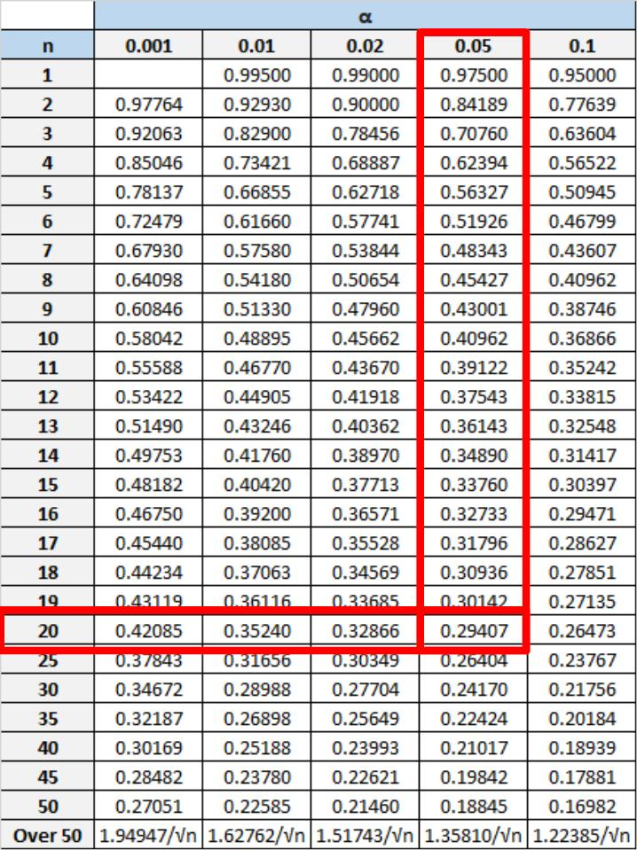

../ Practical Toy Example
D = 0.35
max
α = 0.05
n = 20
D = 0.29407
c
D >D
max c
Reject H₀
Statistics for Software Engineers
© Hadas Lapid all rights

